Slide 1


J.K.K MUNIRAJAH COLLEGE OF TECHNOLOGY
T.N. PALAYAM, GOBI-638506
VIRTUAL REALITY TOURISM
SUBMITED BY,
GOKUL S
LENATAMILVANAN G
RAVISANKARAN N
GUIDED BY,
Dr.N. SATHYABALAJI M.E.Ph.D.,M.I.S.T.E

Slide 2
ABSTRACT
Virtual reality (VR) technology has revolutionized the way we experience and explore the world. This abstract provides an overview of the concept of virtual reality tourism and its implications for the travel industry. Virtual reality tourism refers to the use of VR technology to create immersive and interactive simulations of real or imagined travel destinations. By putting on a VR headset, users can transport themselves to any location, whether it's a bustling city, a historical site, or a natural wonder, and experience it as if they were physically present.

Slide 3
OBJECTIVE
Virtual tourism aims to create a near-life touring experience of a particular destination or tourist attraction.
Virtual tourism can provide a glimpse of what a destination or tourist attraction has to offer.
it can also be used to plan a future in-person trip

Slide 4
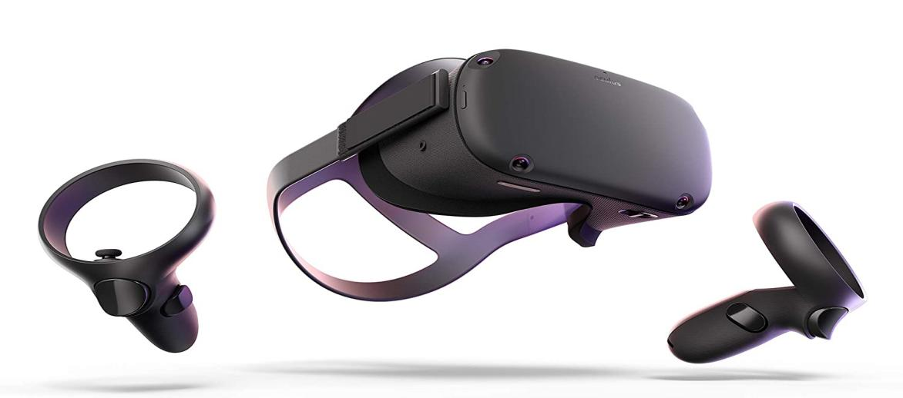
Virtual Reality ?
Virtual reality is a simulated experience that employs pose tracking and 3D near-eye displays to give the user an immersive feel of a virtual world. Applications of virtual reality include entertainment, education and business.

Slide 5
Virtual Reality In Tourism :
Virtual tourism projects aim to provide immersive and interactive experiences that allow individuals to explore destinations and cultural attractions remotely. These projects typically utilize virtual reality (VR), augmented reality (AR), or 360-degree video technologies to create realistic and engaging environments.

Slide 6
ADVANTAGES
Travelers can get a 3D tour before touching down
Virtual reality can help with planning sights to see
Travelers can use VR technology when there are delays in the travel schedule
Virtual reality is great for touring the plane ahead of time
Travel coordinators can create engaging presentations using VR

Slide 7
DRAWBACKS OF EXISTING SYSTEM
Lack of physical interaction
Accuracy
Technical limitations
Virtual tourism is inaccessible in some regions
Less economic benefits from virtual tours
Undertourism

Slide 8
SOFTWARE REQUIREMENT
Browser : Chrome Browser
Application : V360*

Slide 9
HARDWARE SPECIFICATIONS
Mobile : Android (or) IOS
VR Glass : Mobile VR glass
Audio : Head set

Slide 10
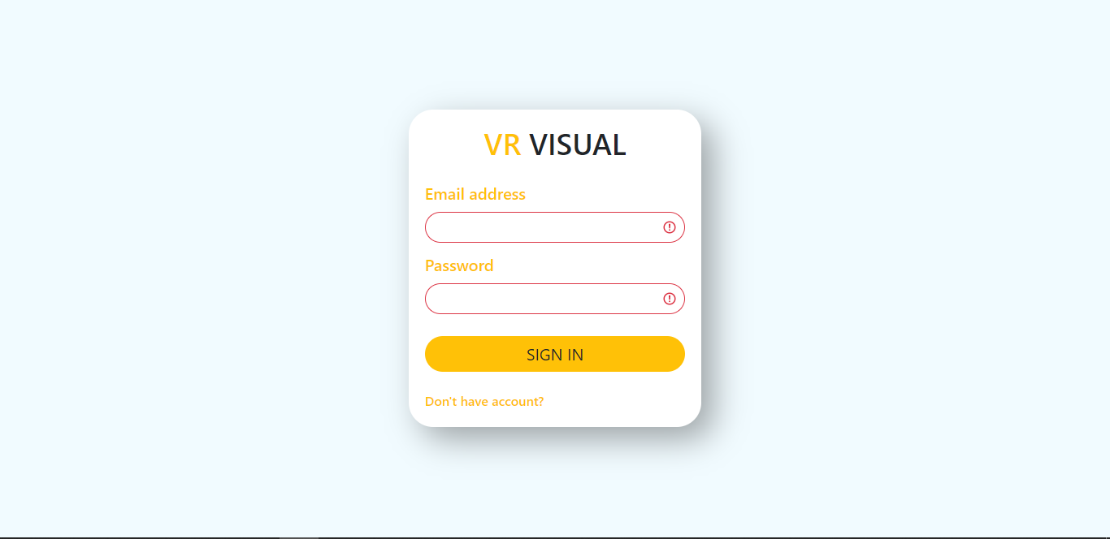
LOGIN PAGE

Slide 11
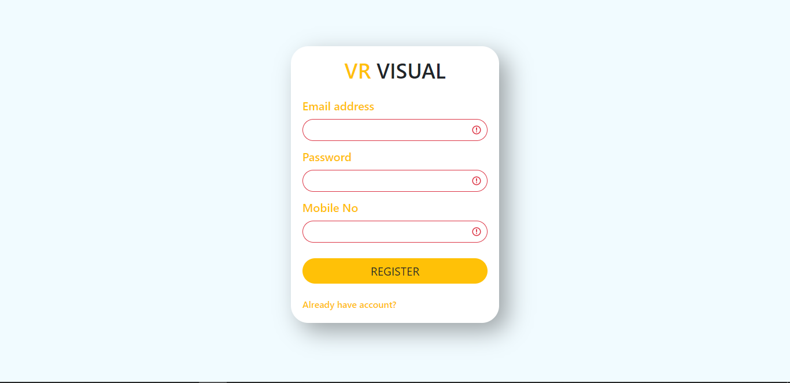
REGISTRATION PAGE

Slide 12
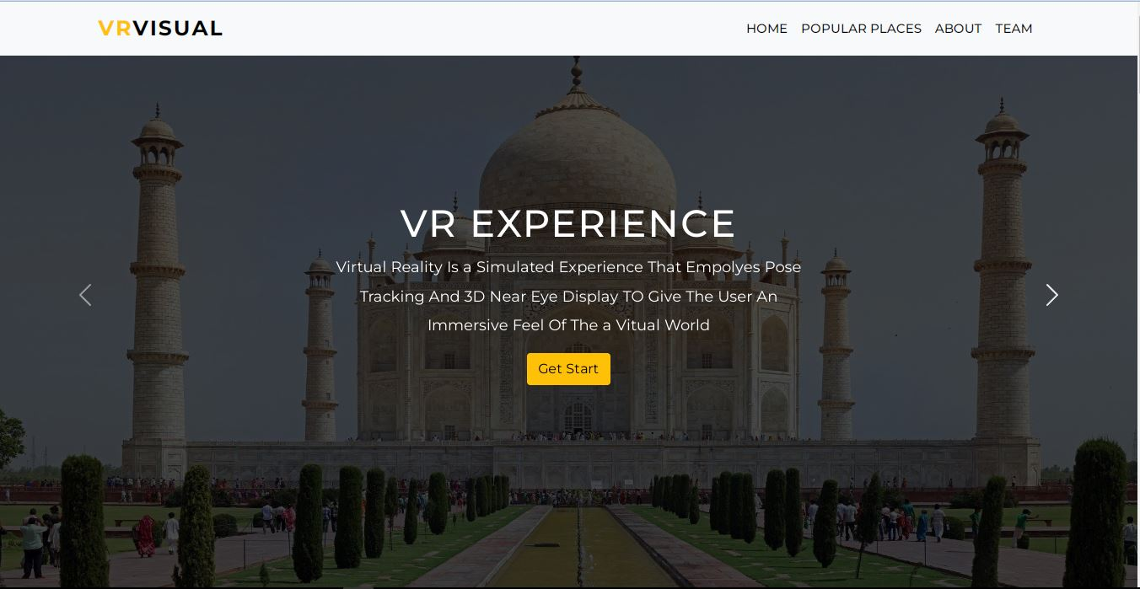
HOME PAGE

Slide 13
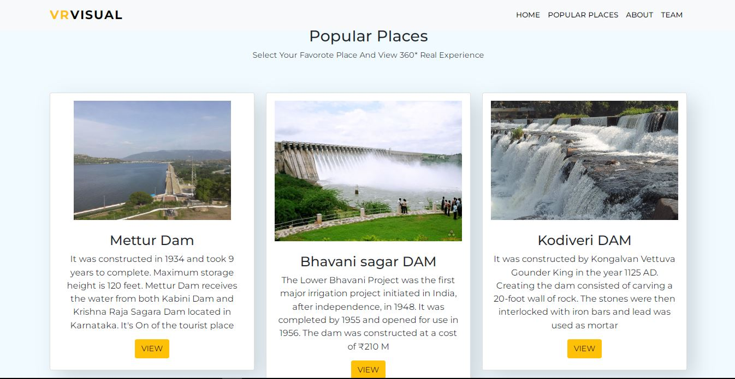
TOURIST PLACES

Slide 14
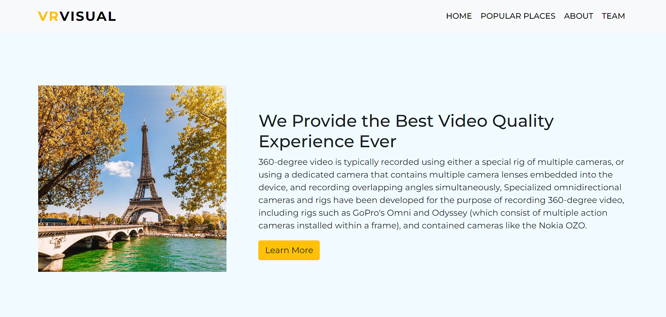
ABOUT PAGE

Slide 15
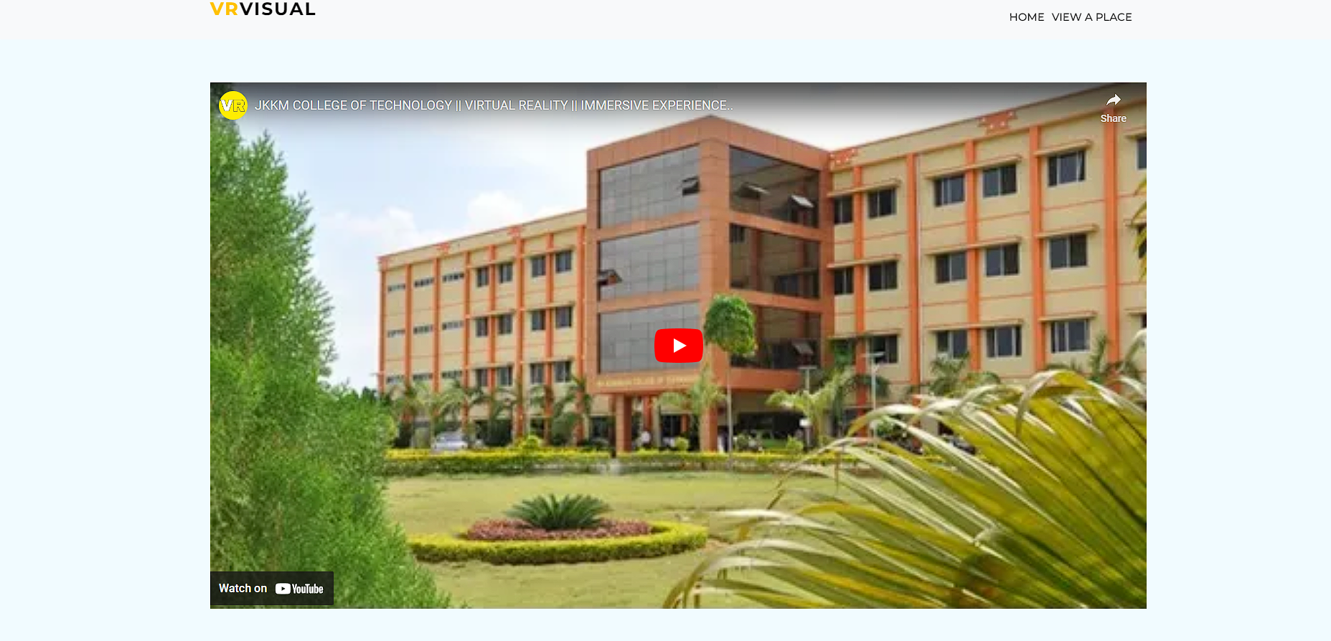
VISITER PAGE

Slide 16
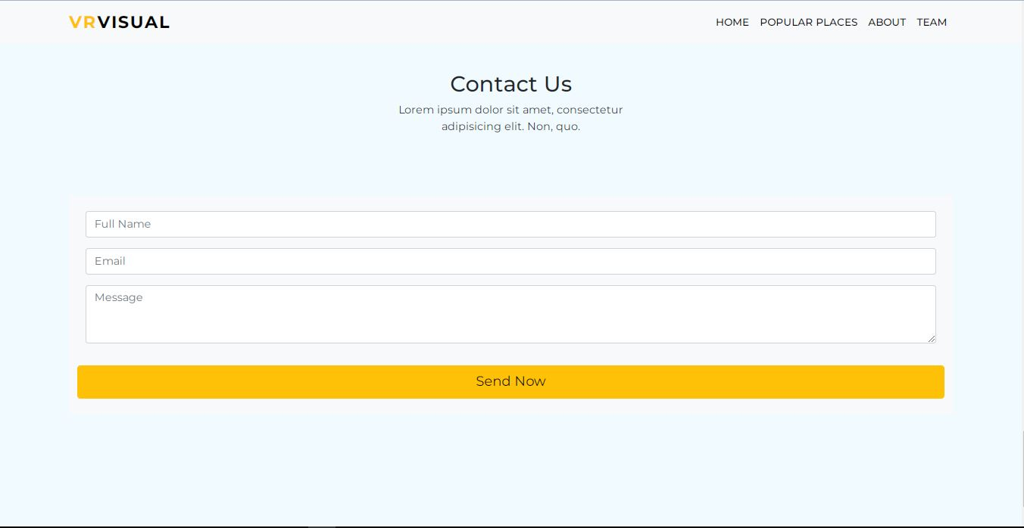
CONTACT US PAGE

Slide 17
CONCLUSION
In conclusion, virtual tourism offers numerous benefits and opportunities for both tourists and the tourism industry. It leverages technology to provide immersive and interactive experiences that simulate real-world travel and exploration. Here are some key points to summarize the concept of virtual tourism Accessibility Virtual tourism breaks down barriers by making travel experiences accessible to a wider audience.

Slide 18
FUTURE ENHANCEMENT
The future of virtual tourism holds promising opportunities for enhancement and innovation. Here are some potential areas for future development and improvement in virtual tourism Advancements in Virtual Reality (VR) and Augmented Reality (AR): The use of VR and AR technologies in virtual tourism can become more sophisticated, offering more realistic and immersive experiences.

Slide 19
REFERENCES
IEEE-utilizing VR technologies in immersive tourism Experiences.
AirPano (www.airpano.com): Provides immersive 360-degree aerial panoramas of various destinations, allowing users to virtually explore iconic locations.
National Park Service (www.nps.gov): Offers virtual tours and multimedia experiences of national parks in the United States.
VirtualTourist (www.virtualtourist.com): Features user-generated virtual tours, travel guides, and photos from destinations around the world.

Slide 20
WEB REFERENCES
VRBO - Virtual Tours: https://www.vrbo.com/virtual-tours
Lonely Planet - Virtual Travel: https://www.lonelyplanet.com/travel-tips-and-articles/virtual-travel-painting-the-town-red-from-your-couch
Visit.org - Virtual Tours and Experiences: https://www.visit.org/virtual-tours/
Wanderlust - Virtual Travel: https://www.wanderlust.co.uk/content/the-best-virtual-tours-and-online-experiences/
360Cities - Virtual Tours and Panoramas: https://www.360cities.net
EarthCam - Live Webcams and Virtual Tours: https://www.earthcam.com/

Slide 21
THAnKING YOU !!!

